Slide 1




Modeling Complex Random Memristor Networks
Daniel Teal
Mech. Eng. & Math, UT Austin
Dr. Tomonobu Nakayama
Nano Functionality Integration Group at MANA, NIMS

Slide 2
Novel Electronics
Computers aren’t getting much faster.
(2D photolithographic silicon/CMOS)
search for new computing methods
3D circuitry
quantum computing
programmable hardware (FPGA)
photonic computing
neuromorphic computing
(nanowire electronics)

Slide 3
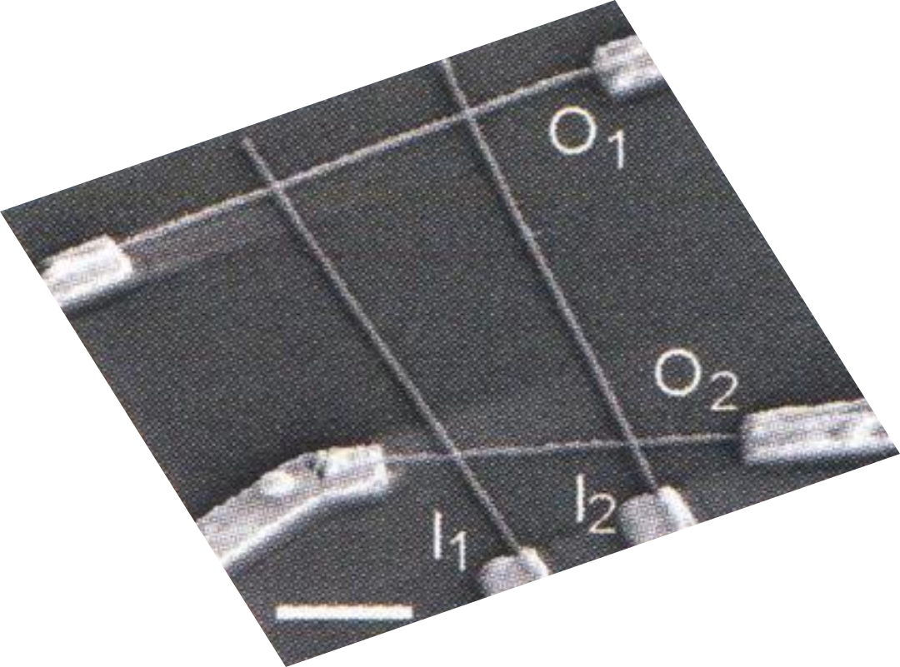
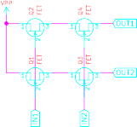
Nanowires for Electronics
Nanowire (NW): 1D cylinder of Ag, Si, Au...
NW-NW junction = circuit element
equivalent circuit
nanowire
transistors
(1 µm scale)
Zhong, Z., Wang, D., Cui, Y., Bockrath, M. W., & Lieber, C. M. (2003). Nanowire Crossbar Arrays as Address Decoders for Integrated Nanosystems. Science, 302(5649), 1377–1379. https://doi.org/10.1126/science.1090899

Slide 4
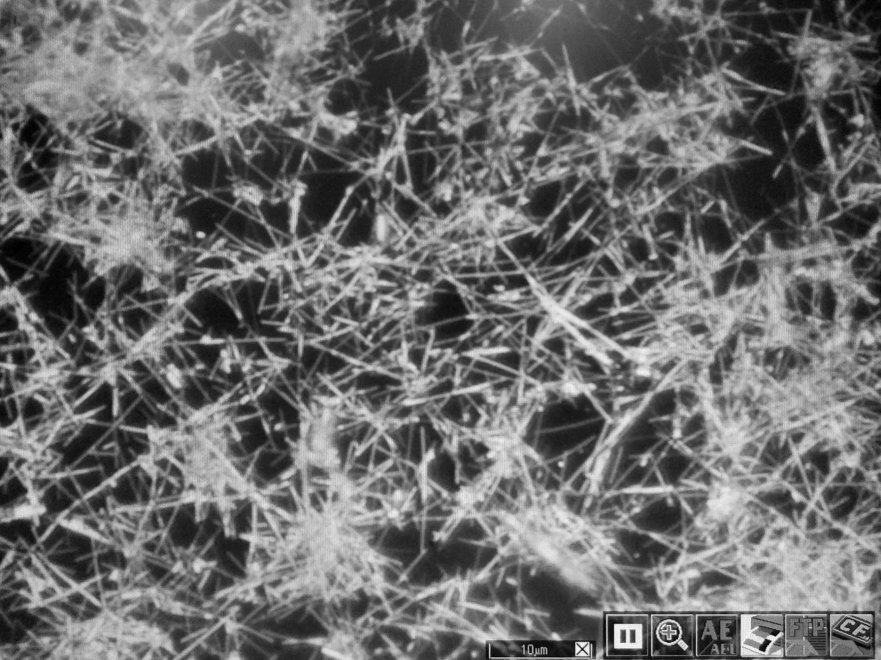
PVP@Ag Nanowire Networks
collection of Ag nanowires with PVP coating
model properties, understand potential
similar to neural network?
10µm x 50nm Ag
5nm PVP polymer
schematic of
10 µm
single nanowire
image of a PVP@Ag network

Slide 5
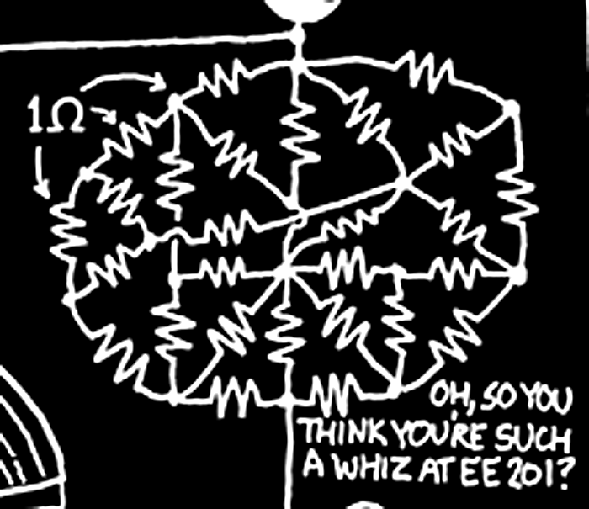
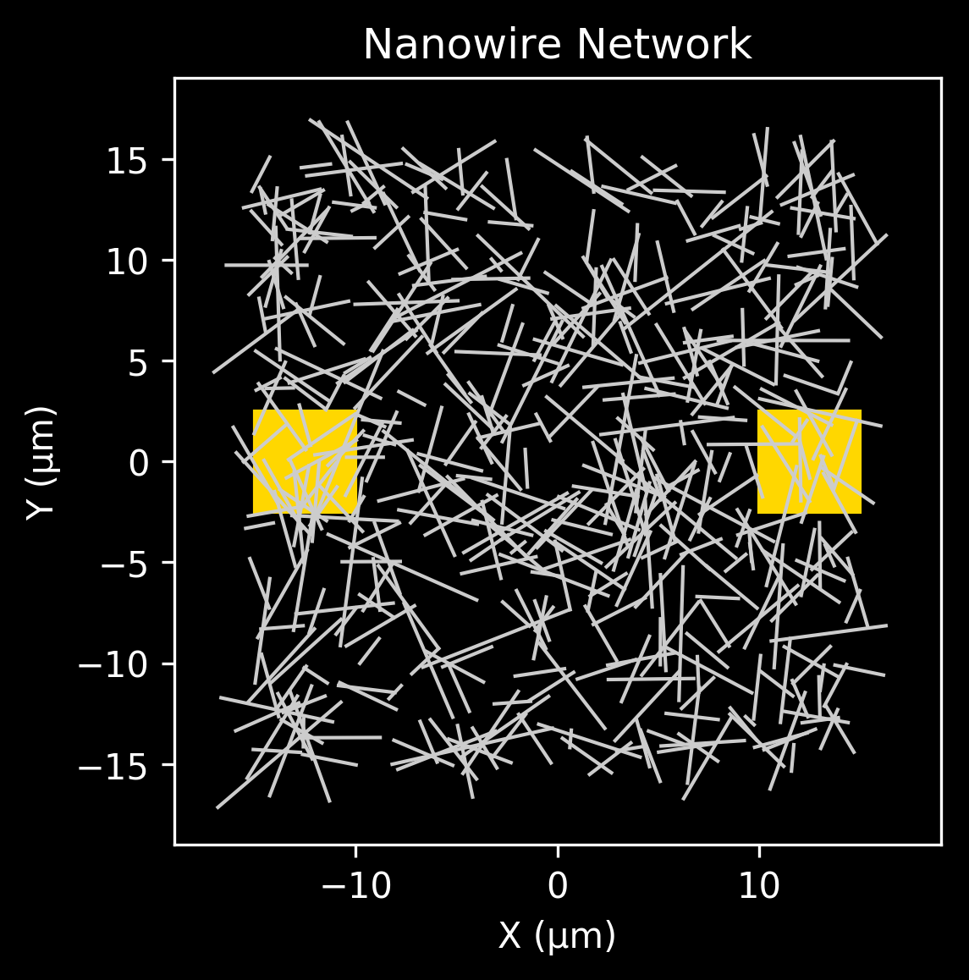
Step 1: Create Simulation
memresistor junction model
current
no current, wait for time
filament forms
resistance decreases
filament decreases
returns to original state
a complete simulated network
equivalent circuit
Munroe, R. Circuit Diagram. XKCD 730.

Slide 6
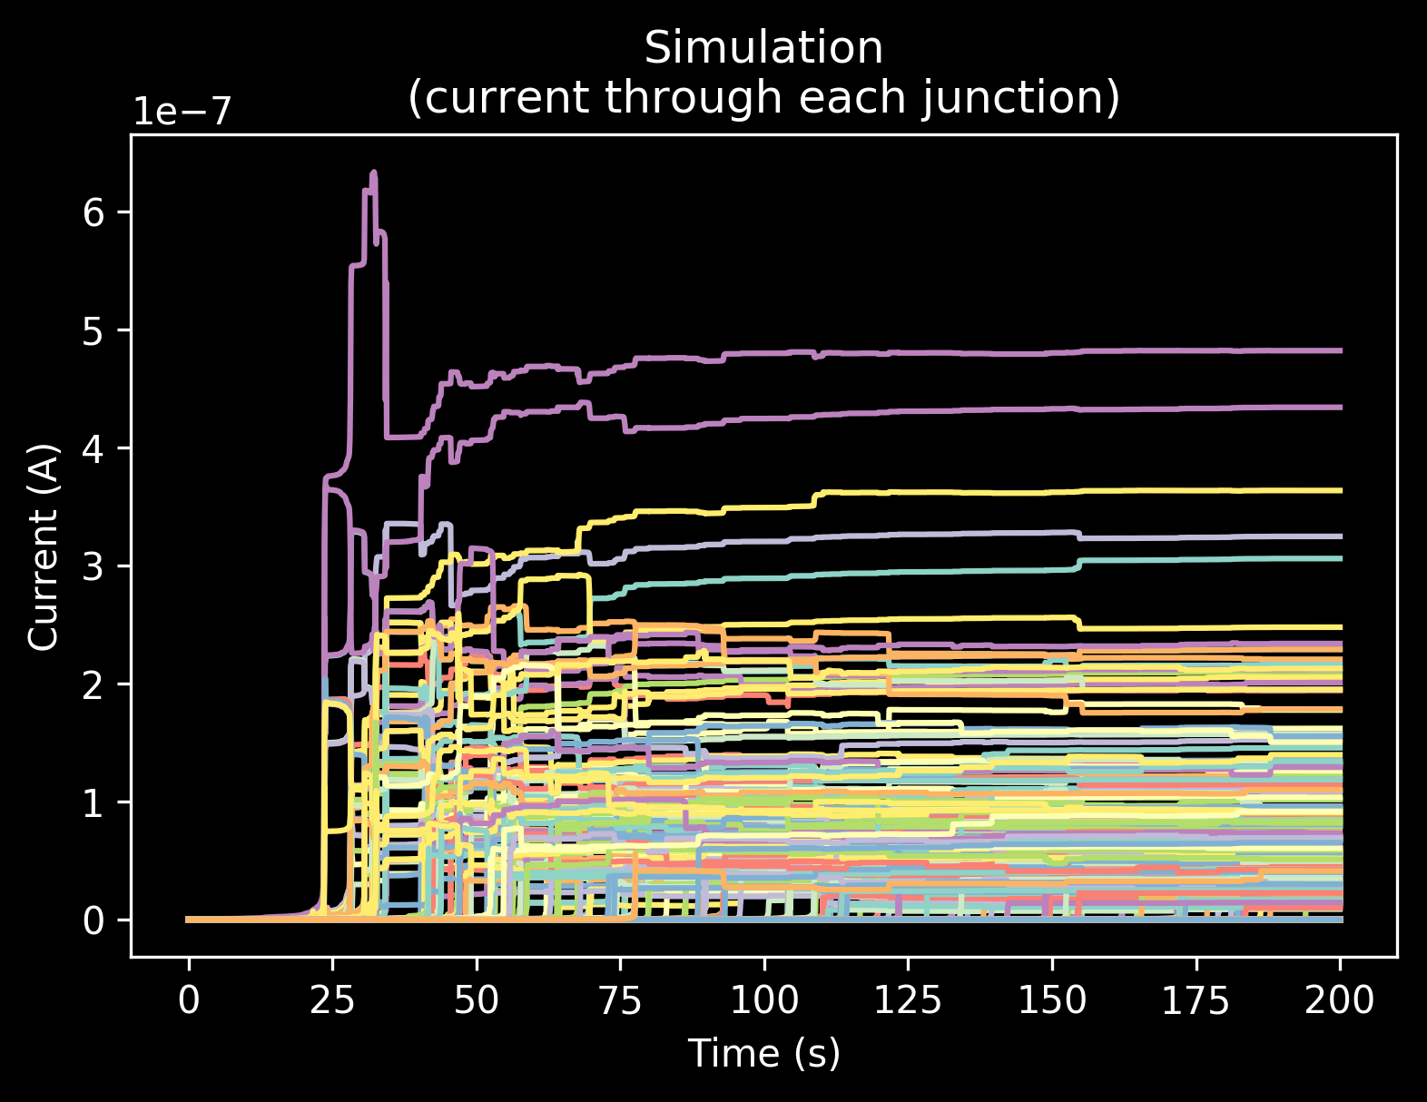
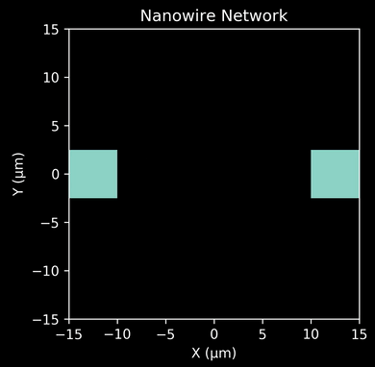
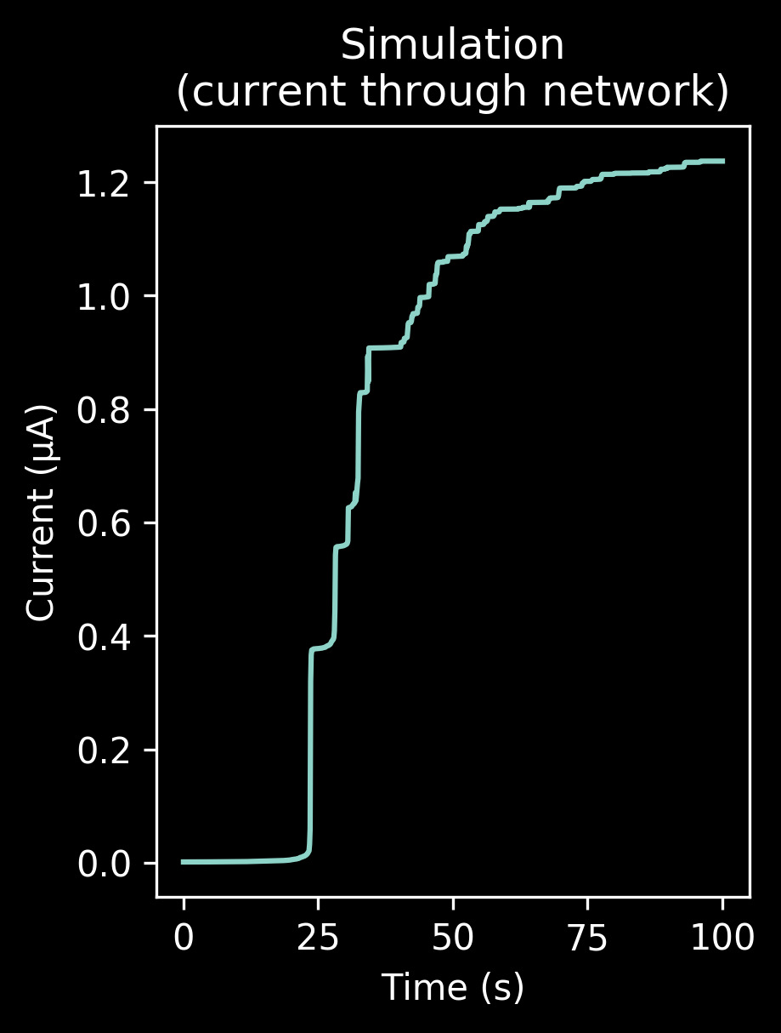
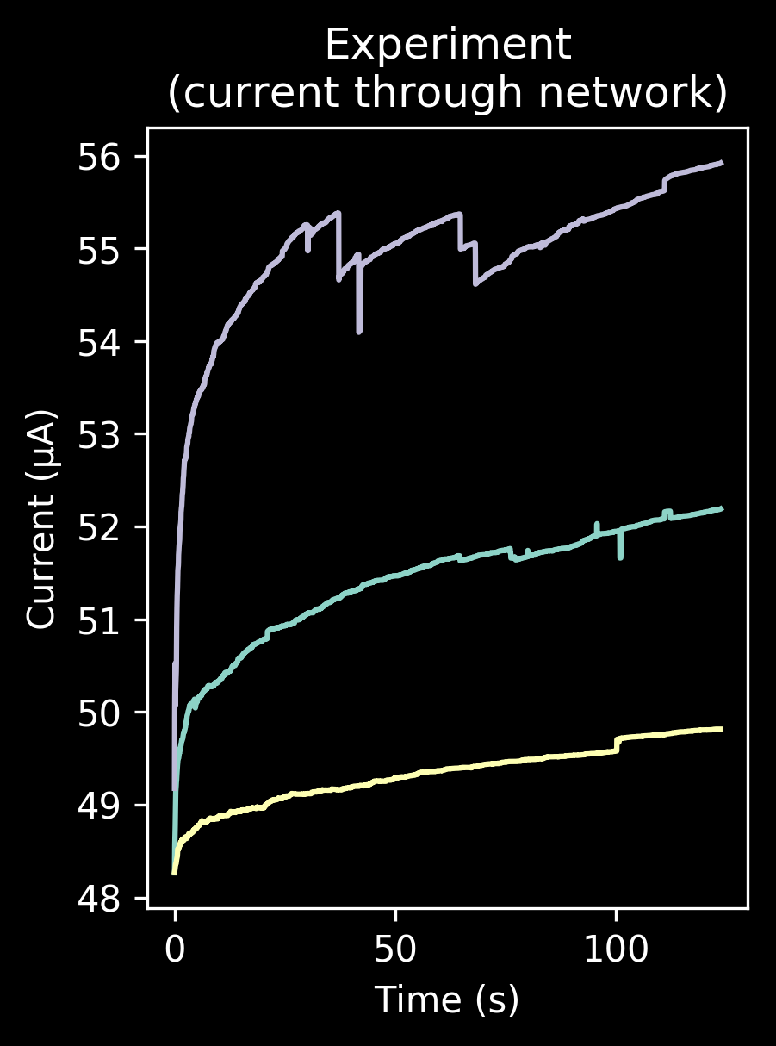
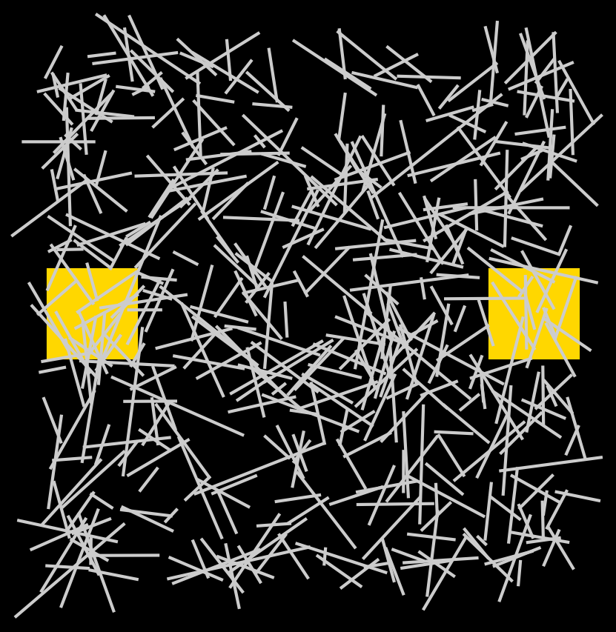
Step 2: Response to Constant Voltage
+ V
A
GND
relative current density over time

Slide 7
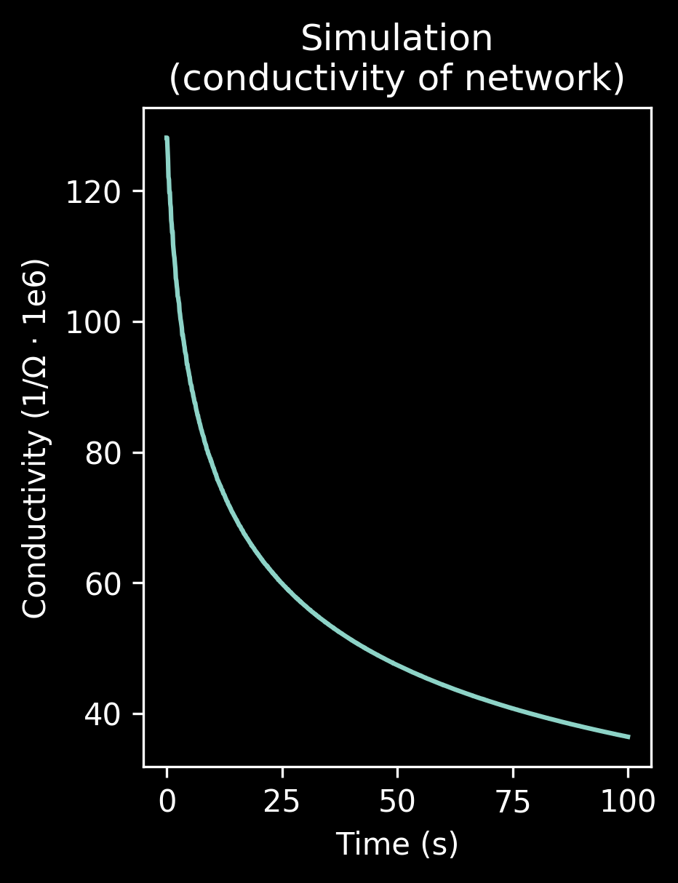
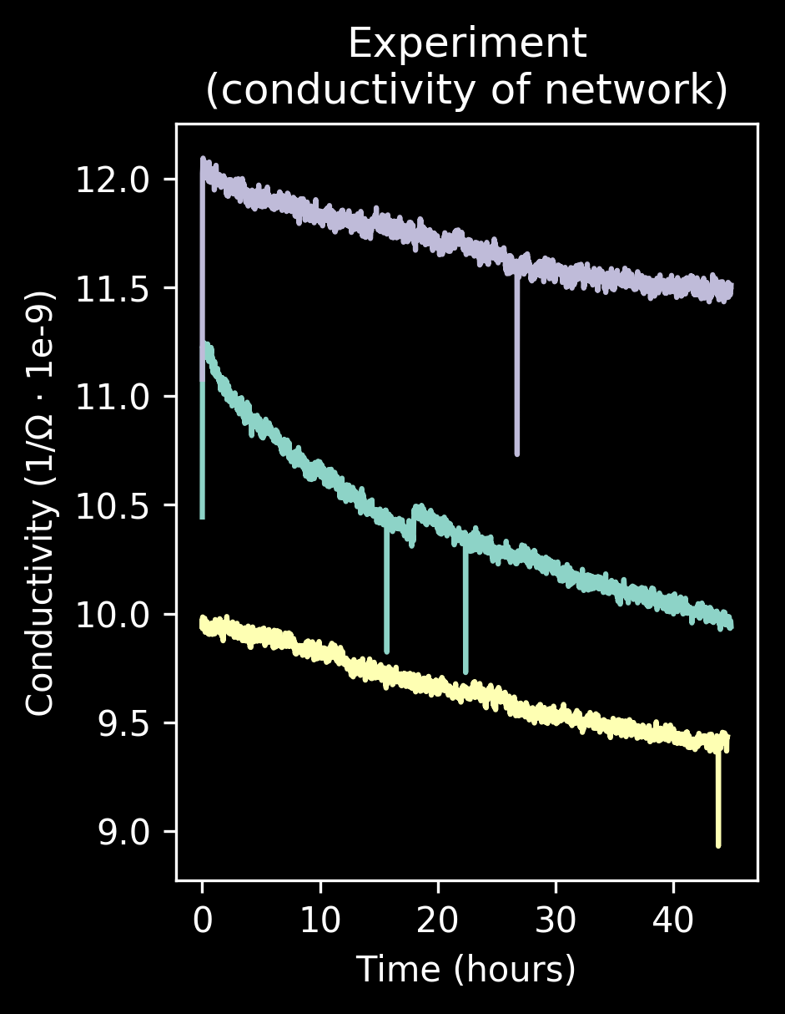
Step 3: Resistance Decay with Time
+ (small) V
A
GND
full decay is very slow- weeks!

Slide 8
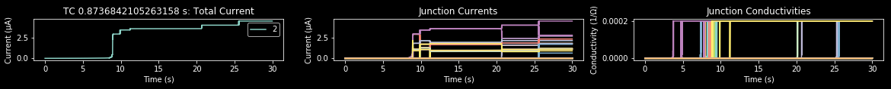
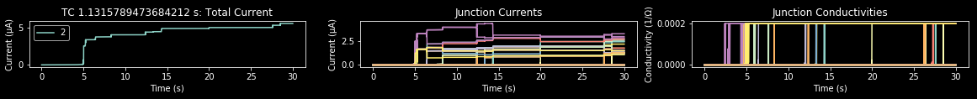
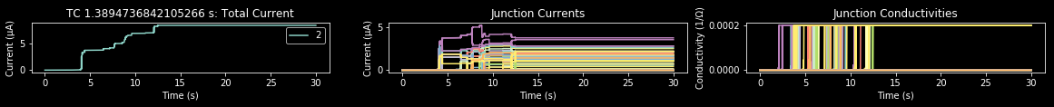
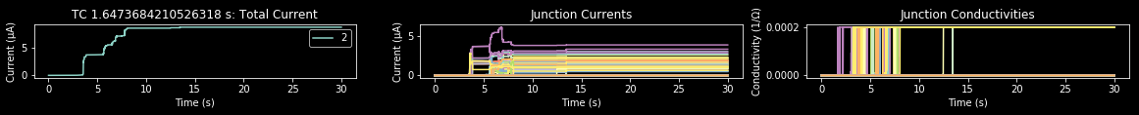
Parameter sweep found nothing else

Slide 9

One use: current switch
time
+V
+V
0
0
+V
0
0
+V
+V
0
+V
0
white indicates current flow
switch simulation

Slide 10

Conclusions
Simulation predicts behavior
Junction memristor hypothesis supported
Network acts like planar memristor
Applications:
Switch for a finite state machine
Ephemeral memory: information that disappears after a week
Custom non-CMOS electronics
Planar memristance
10 µm
Future work:
Attempt to control memristor parameters (decay, resistance)
Add capacitance for higher-order behavior

Slide 11
Acknowledgements
NIMS and MANA
National Science Foundation
NSF grant no. OISE-1559368
National Nanotechnology Coordinated Infrastructure
PI: Dr. Tomonobu Nakayama
Nano Functionality Integration Group: Qiao Li, Adrian, Sasaya...
Dr. Lynn Rathbun and other program coordinators

Slide 12
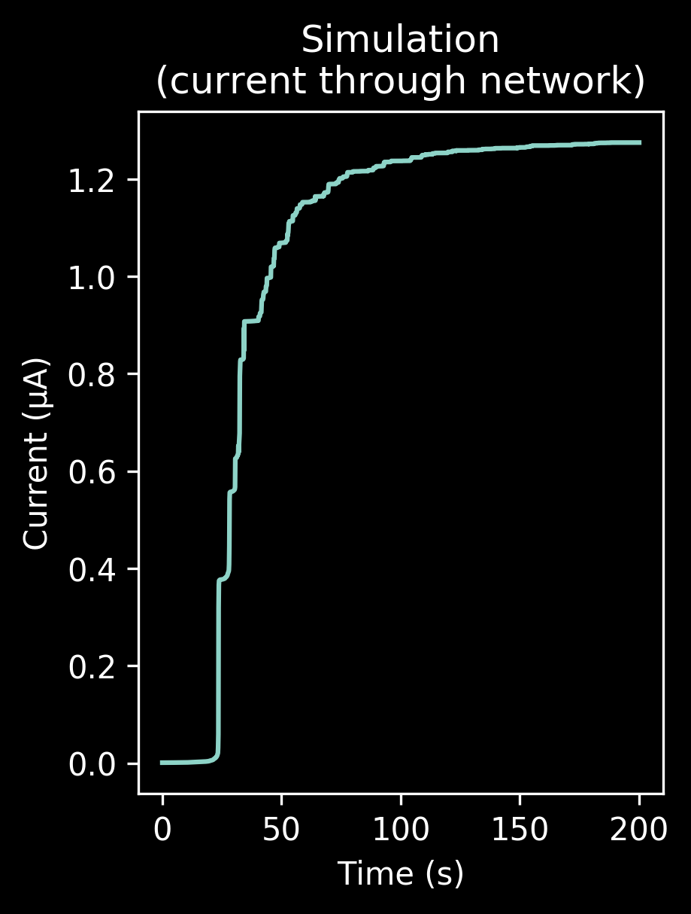
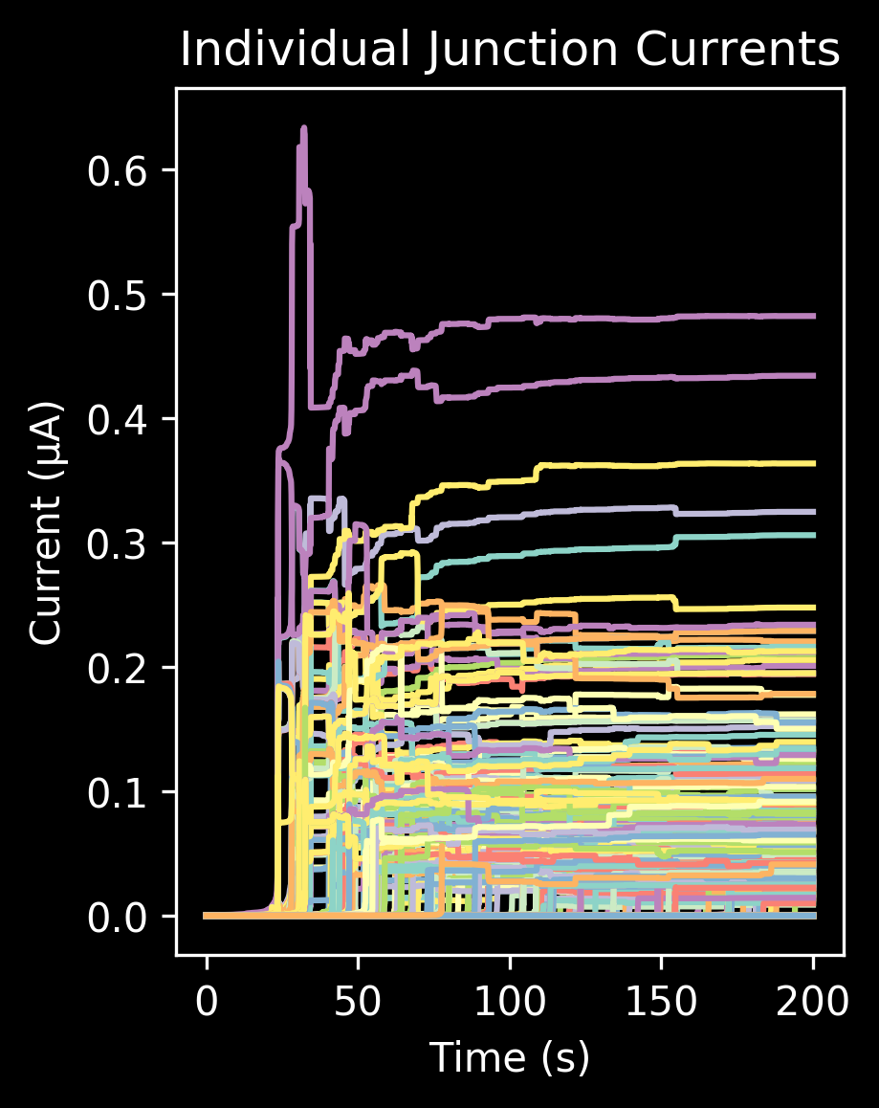
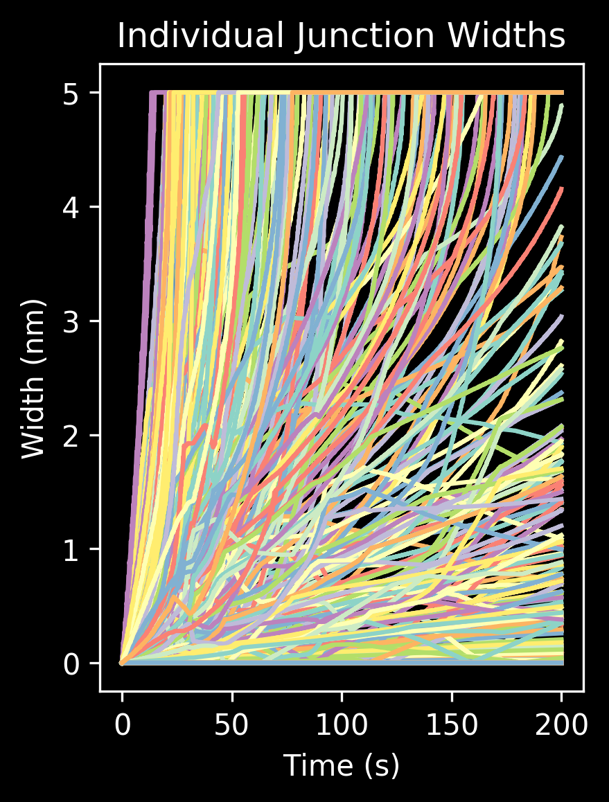
Junction Behavior

Slide 13




NW-NW Junction Electrical Model

Slide 14
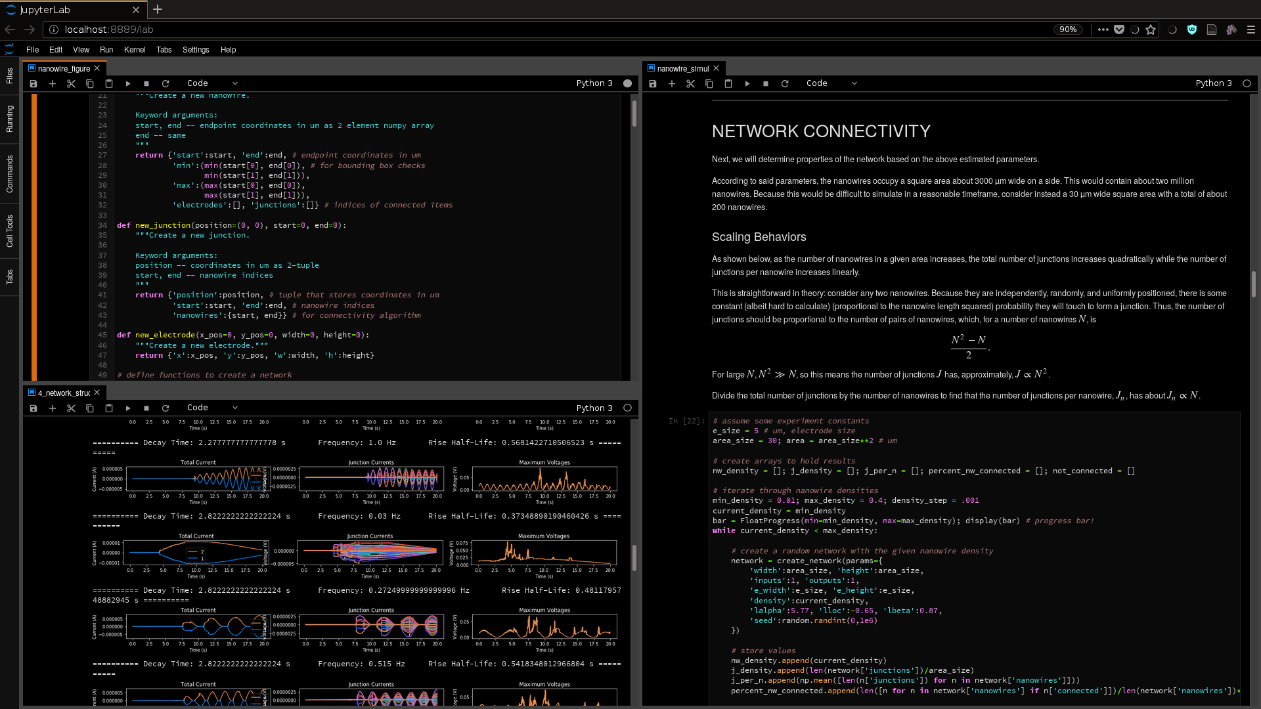



Programming Environment

Slide 15
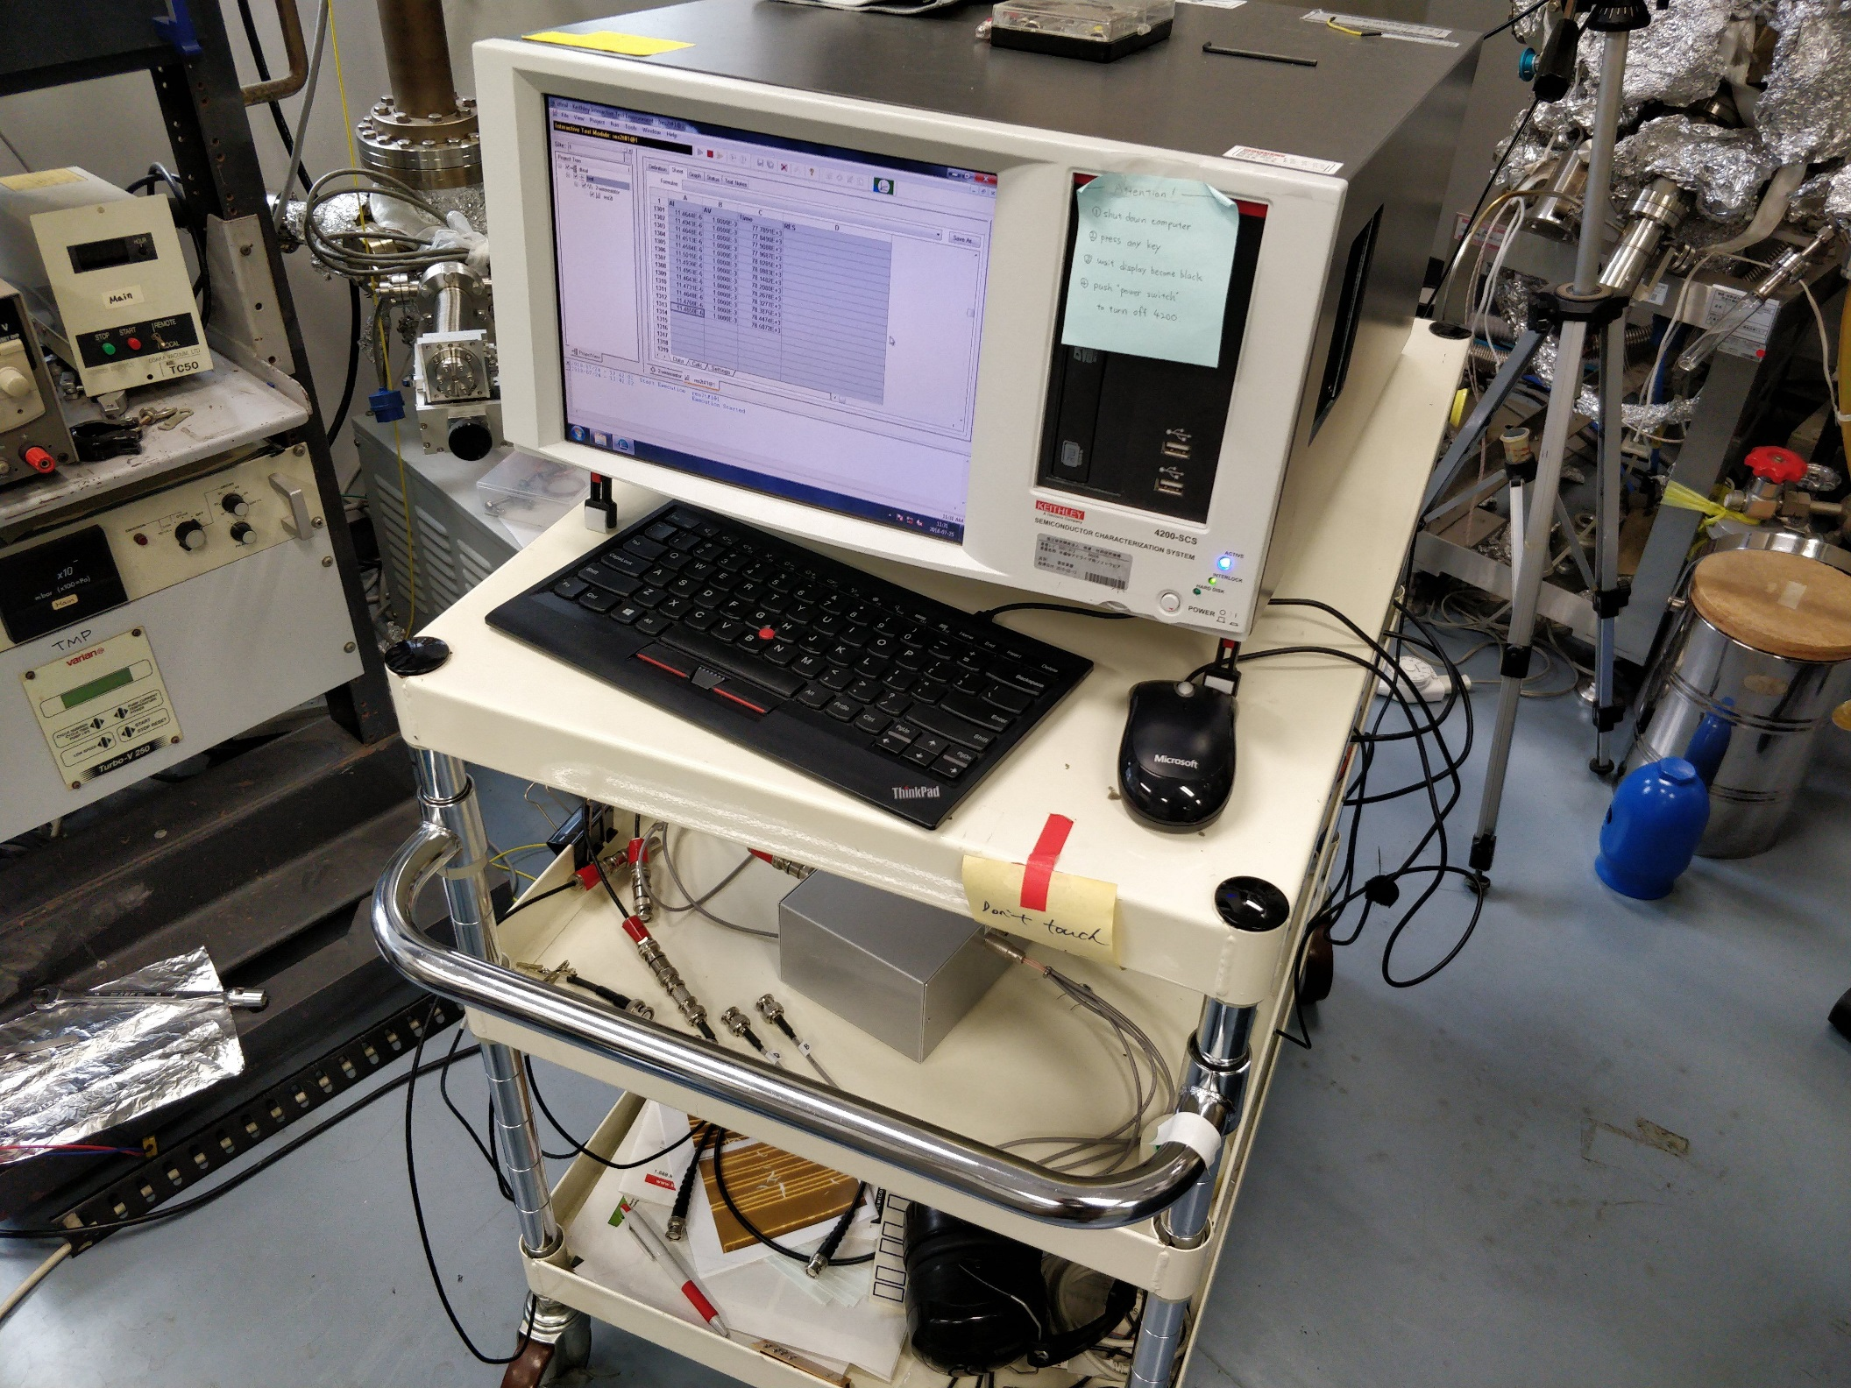
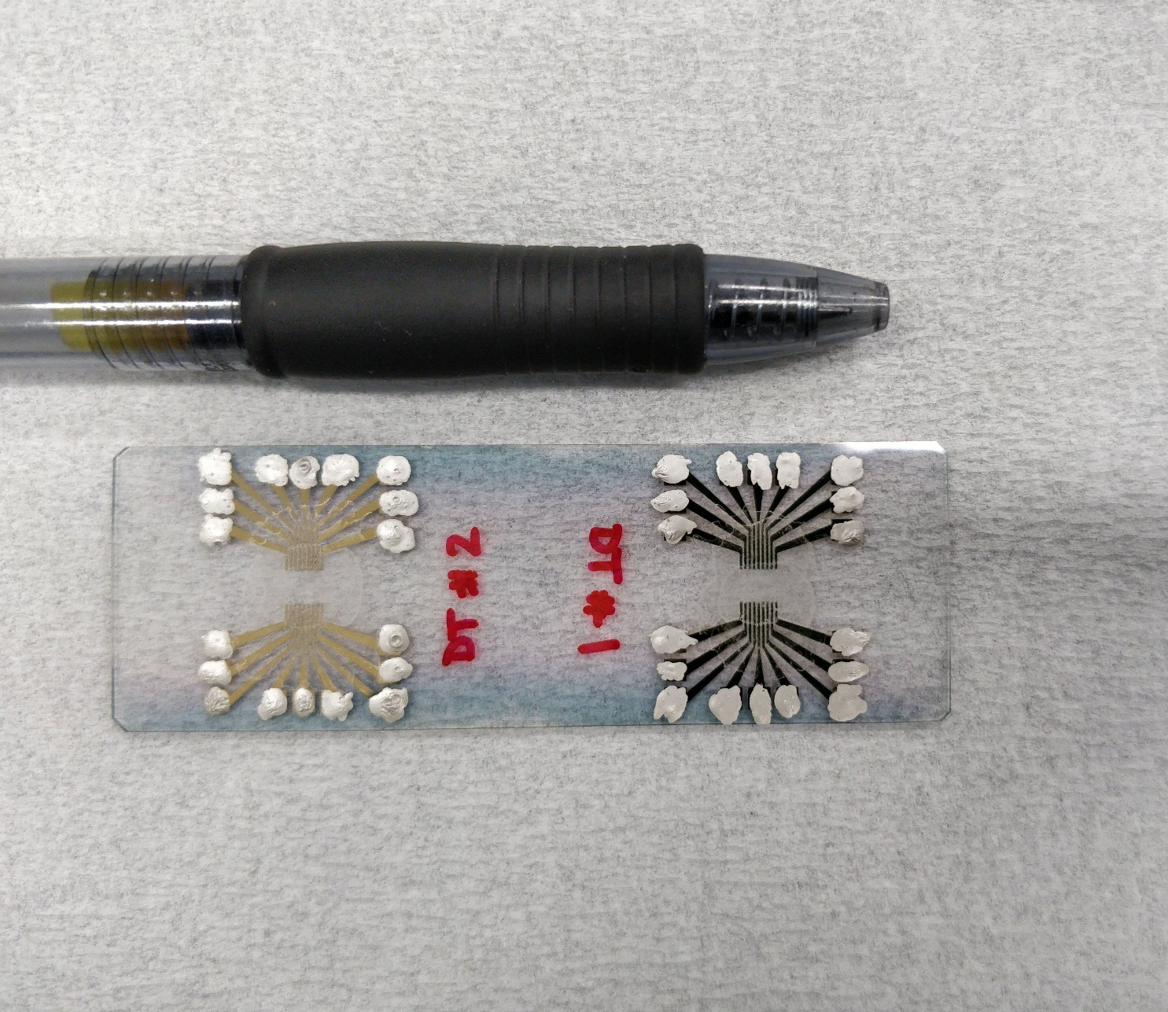
Test Apparatus
Test devices
Keithley SCS 4200

